Slide 1
Dynamic routing using FLSM and VLSM

Slide 2
Poll 1
Subnet is end result of dividing a network into two or more networks
Yes
No

Slide 3
FLSM subnetting
Step 1:decide total number of sub net required , lets say 2
Step 2: calculate required network bits for example is assumed case network one need 30 IP’s and rest IP’s belong to network two
32-5=27 bits
(2^n formula used and 32 is (8.8.8.8 total no of bits ))
Step 3: calculate subnet mask by converting this binary number to decimal for eg.
11100000 =224 hence mask will be: 255.255.255.224
Step 4: Find range by subtracting calculated mask from maximum possible number 255.255.255.255
255.255.255.255
255.255.255.224
-----------------------
0.0.0.31
Range will be
192.10.10.0 to 192.10.10.31

Slide 4
FLSM subnetting
Step 1:decide total number of sub net required , lets say 2
Step 2: calculate required network bits for example is assumed case network one need 30 IP’s and rest IP’s belong to network two
32-5=27 bits
(2^n formula used and 32 is (8.8.8.8 total no of bits ))
Step 3: calculate subnet mask by converting this binary number to decimal for eg.
11100000 =224 hence mask will be: 255.255.255.224
Step 4: Find range by subtracting calculated mask from maximum possible number 255.255.255.255
255.255.255.255
255.255.255.224
-----------------------
0.0.0.31
Range will be
192.10.10.32 to 192.10.10.63

Slide 5
Poll 2
Fixed-length subnet masks can initiate the IP wastage issue
Yes
No

Slide 6
FLSM subnetting
Step 1:decide total number of sub net required , lets say 2
Step 2: calculate required network bits for example is assumed case network one need 30 IP’s and rest IP’s belong to network two
32-5=27 bits
(2^n formula used and 32 is (8.8.8.8 total no of bits ))
Step 3: calculate subnet mask by converting this binary number to decimal for eg.
11100000 =224 hence mask will be: 255.255.255.224
Step 4: Find range by subtracting calculated mask from maximum possible number 255.255.255.255
255.255.255.255
255.255.255.224
-----------------------
0.0.0.31
Range will be
192.10.10.64 to 192.10.10.95

Slide 7
FLSM subnetting
Step 1:decide total number of sub net required , lets say 2
Step 2: calculate required network bits for example is assumed case network one need 30 IP’s and rest IP’s belong to network two
32-5=27 bits
(2^n formula used and 32 is (8.8.8.8 total no of bits ))
Step 3: calculate subnet mask by converting this binary number to decimal for eg.
11100000 =224 hence mask will be: 255.255.255.224
Step 4: Find range by subtracting calculated mask from maximum possible number 255.255.255.255
255.255.255.255
255.255.255.224
-----------------------
0.0.0.31
Range will be
192.10.10.96 to 192.10.10.127

Slide 8
FLSM subnetting
Step 1:decide total number of sub net required , lets say 2
Step 2: calculate required network bits for example is assumed case network one need 30 IP’s and rest IP’s belong to network two
32-5=27 bits
(2^n formula used and 32 is (8.8.8.8 total no of bits ))
Step 3: calculate subnet mask by converting this binary number to decimal for eg.
11100000 =224 hence mask will be: 255.255.255.224
Step 4: Find range by subtracting calculated mask from maximum possible number 255.255.255.255
255.255.255.255
255.255.255.224
-----------------------
0.0.0.31
Range will be
192.10.10.128 to 192.10.10.159

Slide 9
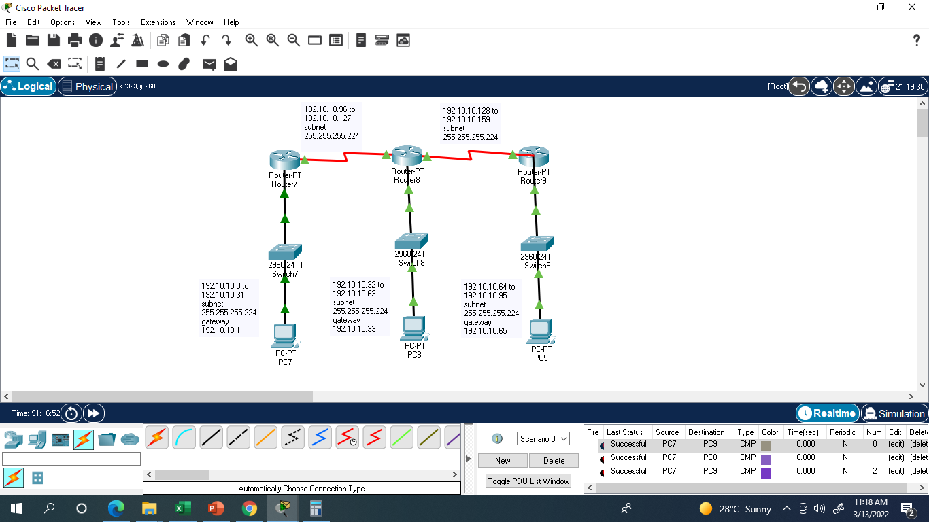

Slide 10
Router 1 setting for RIP
Router>
Router>enable
Router#
Router#configure terminal
Enter configuration commands, one per line. End with CNTL/Z.
Router(config)#router rip
Router(config-router)#version 1
Router(config-router)#network 192.10.10.0
Router(config-router)#network 192.10.10.96
Router(config-router)#

Slide 11
Router 2 setting for RIP
Router>
Router>enable
Router#
Router#configure terminal
Enter configuration commands, one per line. End with CNTL/Z.
Router(config)#router rip
Router(config-router)#version 1
Router(config-router)#network 192.10.10.96
Router(config-router)#network 192.10.10.32
Router(config-router)#network 192.10.10.128
Router(config-router)#

Slide 12
Router 3 setting for RIP
Router>
Router>enable
Router#
Router#configure terminal
Enter configuration commands, one per line. End with CNTL/Z.
Router(config)#router rip
Router(config-router)#version 1
Router(config-router)#network 192.10.10.128
Router(config-router)#network 192.10.10.64
Router(config-router)#

Slide 13
Change the all addresses starting from 192 to180 it will become class less addressing (version 2) for e.g.
Router>
Router>enable
Router#
Router#configure terminal
Enter configuration commands, one per line. End with CNTL/Z.
Router(config)#router rip
Router(config-router)#version 2
Router(config-router)#network 180.10.10.0
Router(config-router)#network 180.10.10.96
Router(config-router)#

Slide 14



Slide 15
Poll 3
What will be sub netmask for class C, 6 IP network
248
250
252
254

Slide 16
VLSM subnetting
Step 1:decide total number of sub net required , lets say 2
Step 2: calculate required network bits for example is assumed case network one need 8 IP’s and rest IP’s belong to network two
32-3=29 bits
(2^n formula used and 32 is (8.8.8.8 total no of bits ))
Step 3: calculate subnet mask by converting this binary number to decimal for eg.
11111000 =248 hence mask will be: 255.255.255.248
Step 4: Find range by subtracting calculated mask from maximum possible number 255.255.255.255
255.255.255.255
255.255.255.248
-----------------------
0.0.0.7
Range will be
192.10.10.96 to 192.10.10.103

Slide 17
VLSM subnetting (variable length subnet mask)
Step 1:decide total number of sub net required , lets say 2
Step 2: calculate required network bits for example in assumed case network one need 64 IP’s and rest IP’s belong to network two
32-6=26 bits
(2^n formula used and 32 is (8.8.8.8 total no of bits ))
Step 3: calculate subnet mask by converting this binary number to decimal for eg.
11000000 =192 hence mask will be: 255.255.255.192
Step 4: Find range by subtracting calculated mask from maximum possible number 255.255.255.255
255.255.255.255
255.255.255.192
-----------------------
0.0.0.63
Range will be
192.10.10.0 to 192.10.10.63

Slide 18
VLSM subnetting
Step 1:decide total number of sub net required , lets say 2
Step 2: calculate required network bits for example is assumed case network one need 30 IP’s and rest IP’s belong to network two
32-5=27 bits
(2^n formula used and 32 is (8.8.8.8 total no of bits ))
Step 3: calculate subnet mask by converting this binary number to decimal for eg.
11100000 =224 hence mask will be: 255.255.255.224
Step 4: Find range by subtracting calculated mask from maximum possible number 255.255.255.255
255.255.255.255
255.255.255.224
-----------------------
0.0.0.31
Range will be
192.10.10.64 to 192.10.10.95

Slide 19
Poll 4
What will be sub netmask for class C, two host network
248
250
252
254

Slide 20
VLSM subnetting
Step 1:decide total number of sub net required , lets say 2
Step 2: calculate required network bits for example is assumed case network one need 4 IP’s and rest IP’s belong to network two
32-2=30 bits
(2^n formula used and 32 is (8.8.8.8 total no of bits ))
Step 3: calculate subnet mask by converting this binary number to decimal for eg.
11111100 =252 hence mask will be: 255.255.255.252
Step 4: Find range by subtracting calculated mask from maximum possible number 255.255.255.255
255.255.255.255
255.255.255.252
-----------------------
0.0.0.3
Range will be
192.10.10.96 to 192.10.10.99

Slide 21
VLSM subnetting
Step 1:decide total number of sub net required , lets say 2
Step 2: calculate required network bits for example is assumed case network one need 4 IP’s and rest IP’s belong to network two
32-2=30 bits
(2^n formula used and 32 is (8.8.8.8 total no of bits ))
Step 3: calculate subnet mask by converting this binary number to decimal for eg.
11111100 =252 hence mask will be: 255.255.255.252
Step 4: Find range by subtracting calculated mask from maximum possible number 255.255.255.255
255.255.255.255
255.255.255.252
-----------------------
0.0.0.3
Range will be
192.10.10.100 to 192.10.10.103

Slide 22
VLSM subnetting
Step 1:decide total number of sub net required , lets say 2
Step 2: calculate required network bits for example is assumed case network one need 4 IP’s and rest IP’s belong to network two
32-2=30 bits
(2^n formula used and 32 is (8.8.8.8 total no of bits ))
Step 3: calculate subnet mask by converting this binary number to decimal for eg.
11111100 =252 hence mask will be: 255.255.255.252
Step 4: Find range by subtracting calculated mask from maximum possible number 255.255.255.255
255.255.255.255
255.255.255.252
-----------------------
0.0.0.3
Range will be
192.10.10.104 to 192.10.10.107

Slide 23
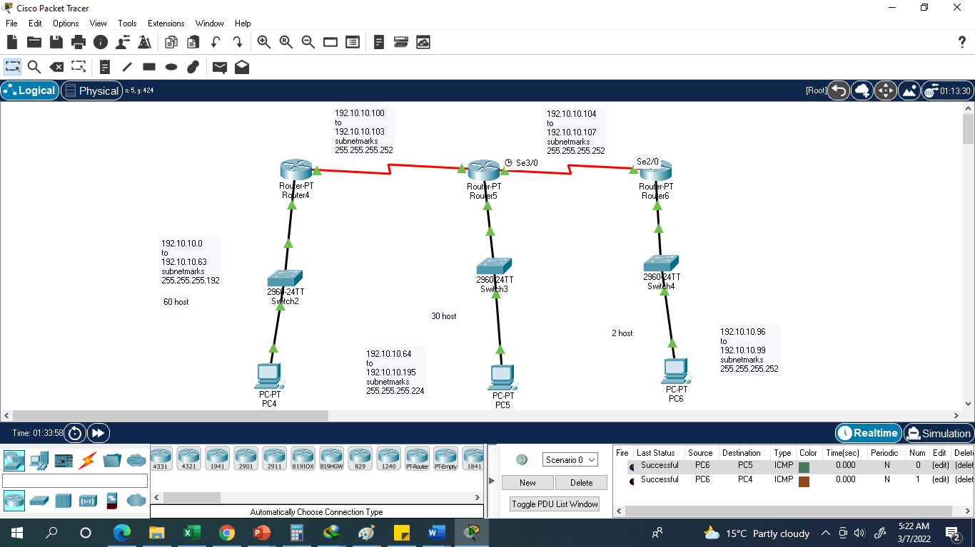

Slide 24
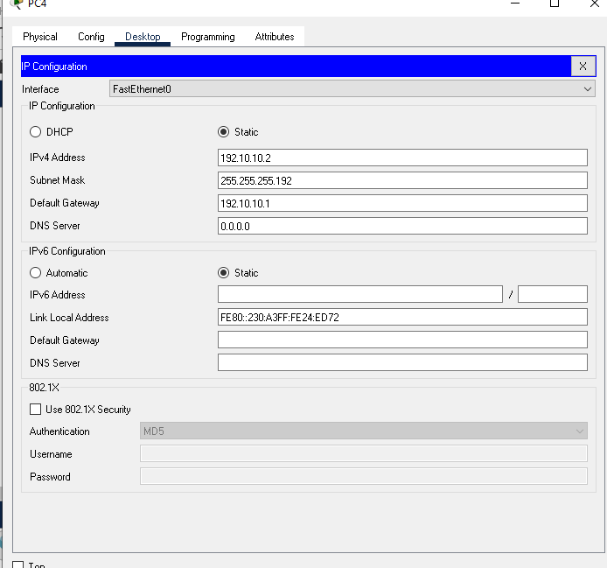

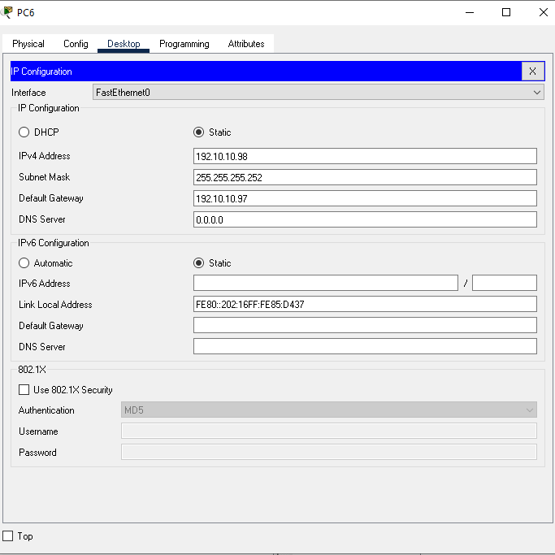

Slide 25
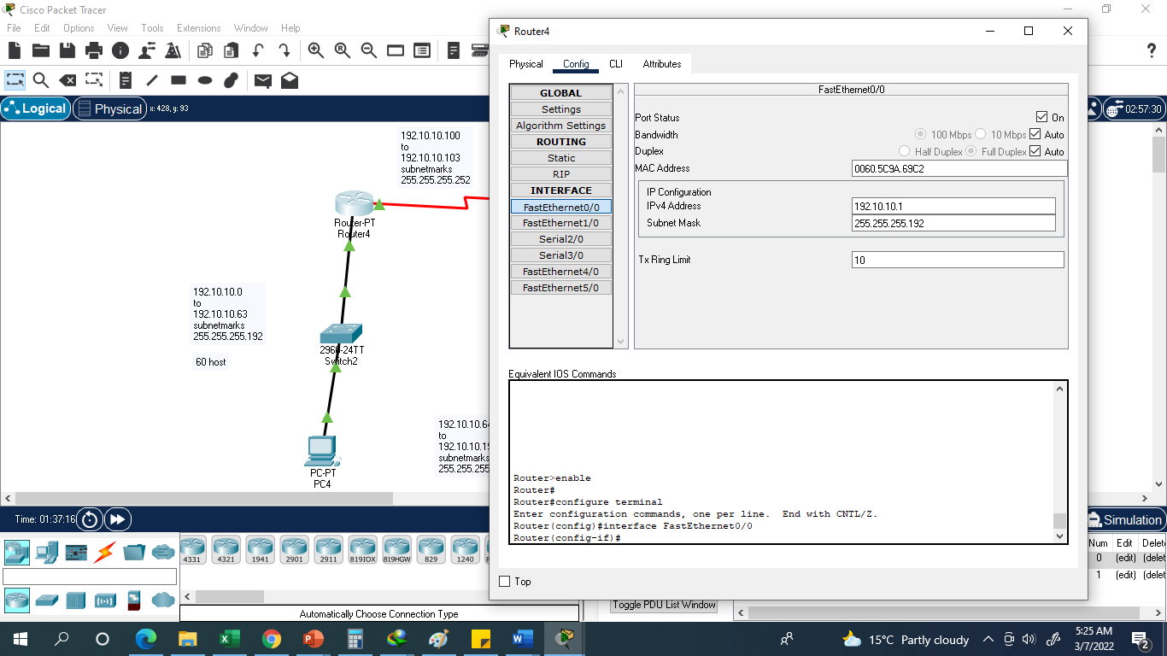

Slide 26
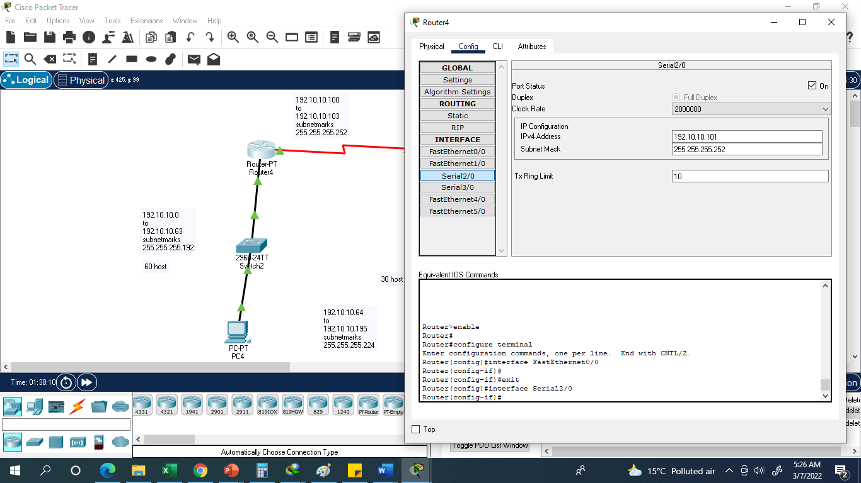

Slide 27
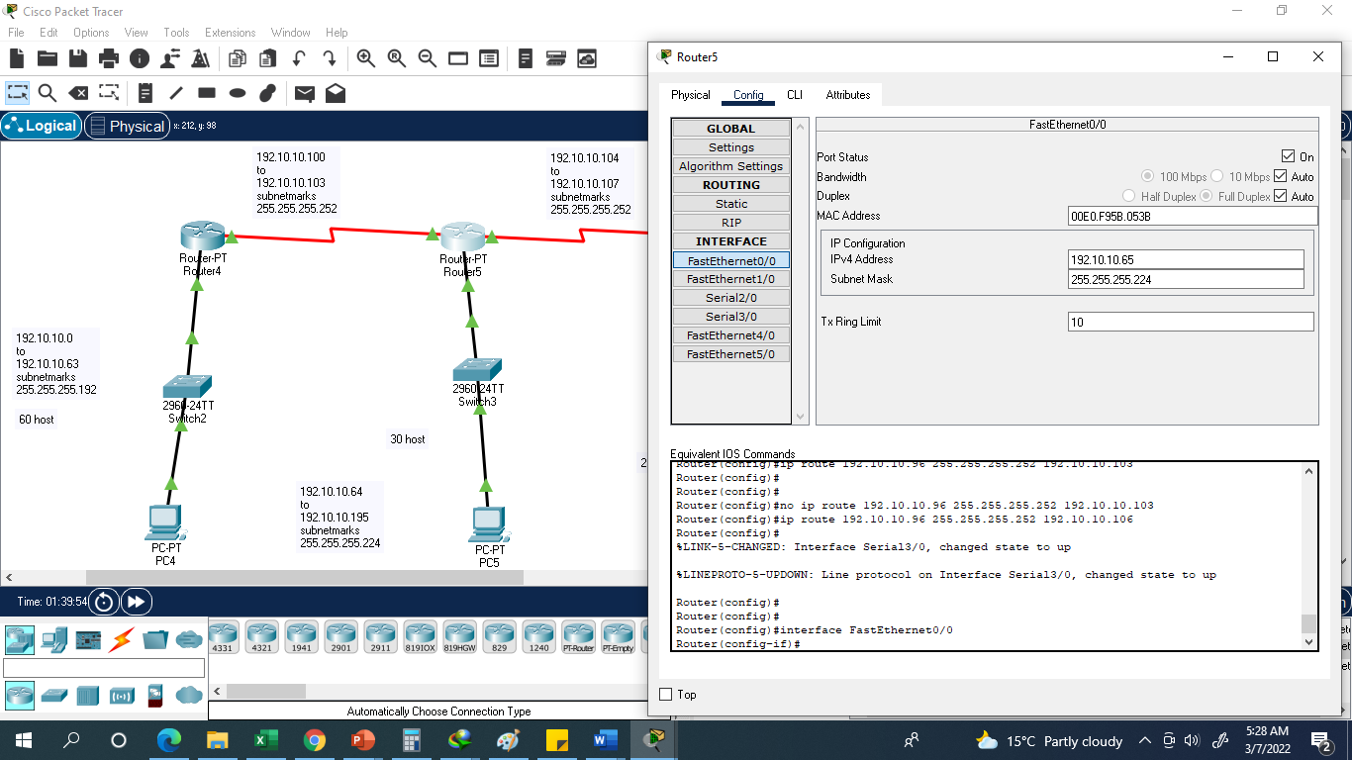

Slide 28
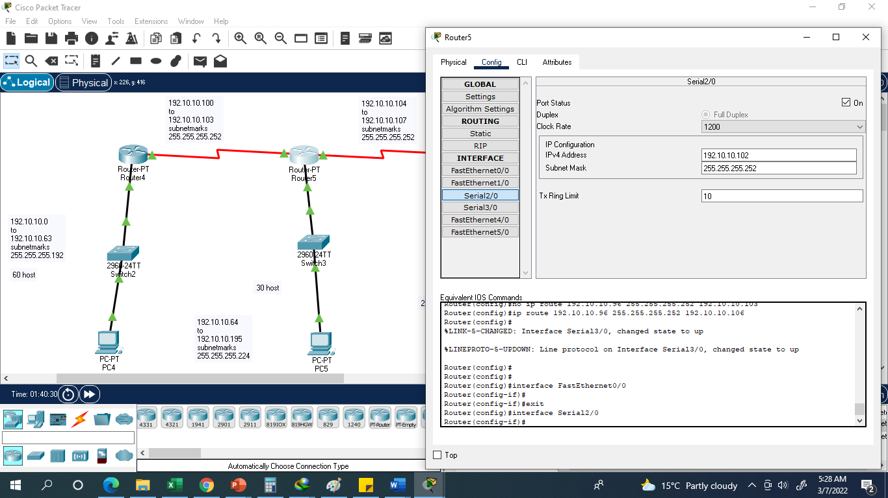

Slide 29
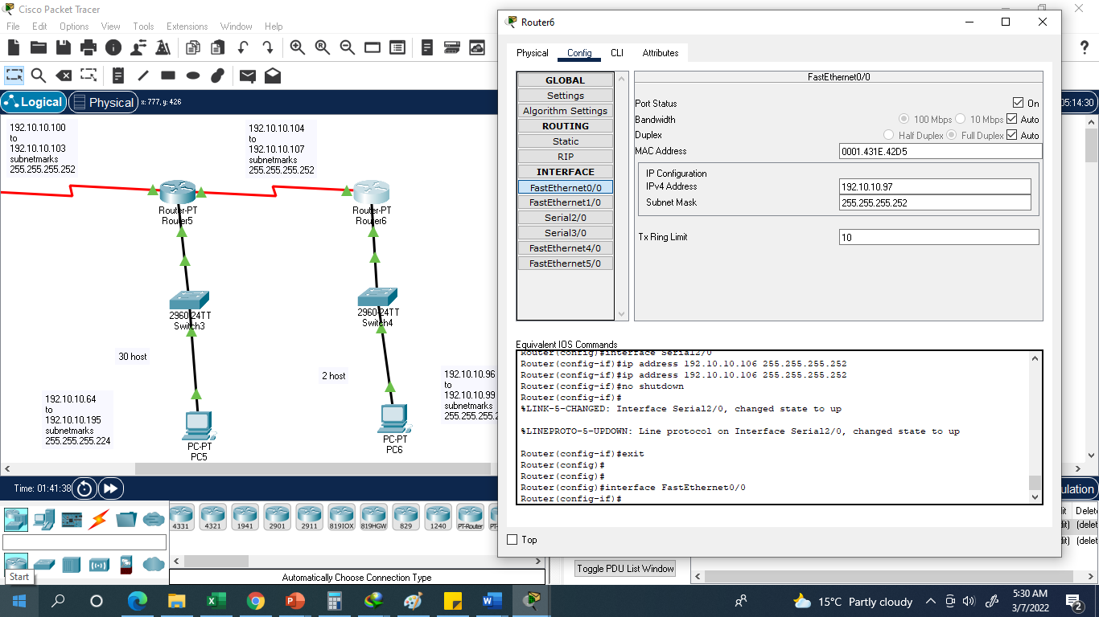

Slide 30
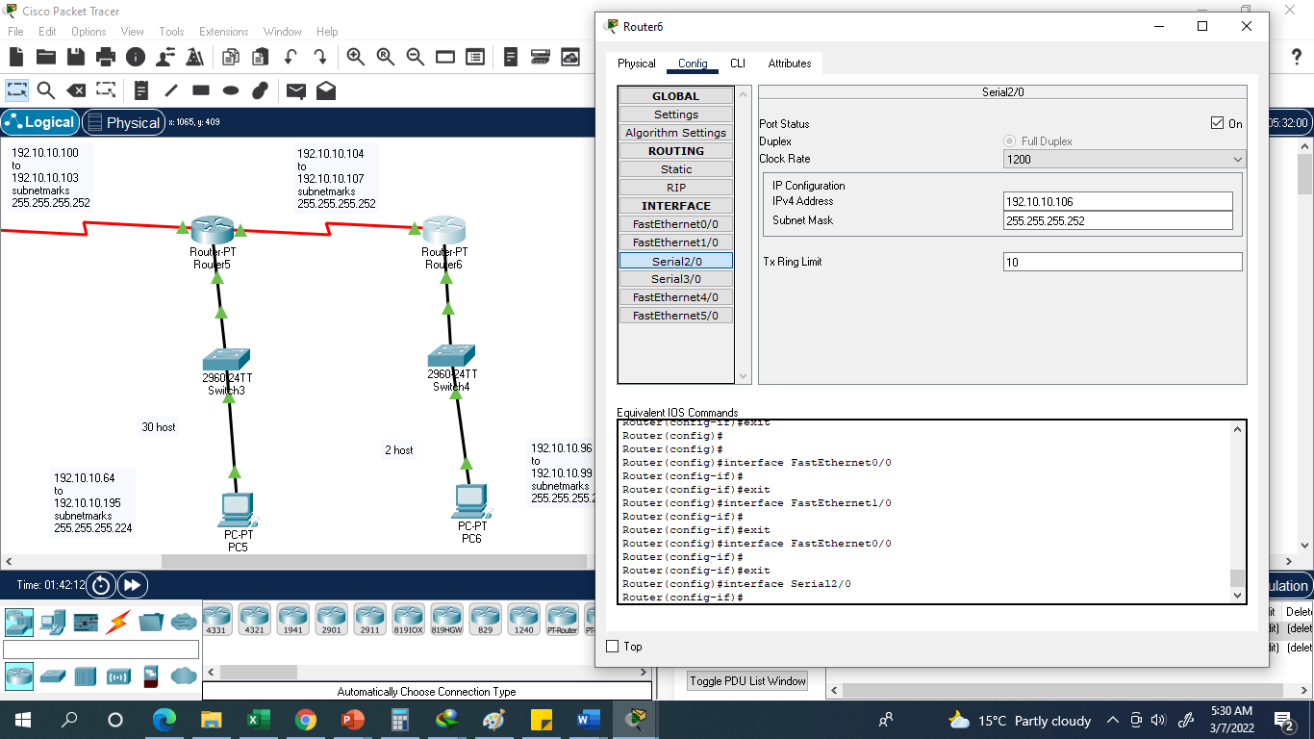

Slide 31
Router 1 setting for RIP
Router>
Router>enable
Router#
Router#configure terminal
Enter configuration commands, one per line. End with CNTL/Z.
Router(config)#router rip
Router(config-router)#version 1
Router(config-router)#network 192.10.10.0
Router(config-router)#network 192.10.10.100
Router(config-router)#

Slide 32
Router 2 setting for RIP
Router>
Router>enable
Router#
Router#configure terminal
Enter configuration commands, one per line. End with CNTL/Z.
Router(config)#router rip
Router(config-router)#version 1
Router(config-router)#network 192.10.10.64
Router(config-router)#network 192.10.10.100
Router(config-router)#network 192.10.10.104
Router(config-router)#

Slide 33
Router 3 setting for RIP
Router>
Router>enable
Router#
Router#configure terminal
Enter configuration commands, one per line. End with CNTL/Z.
Router(config)#router rip
Router(config-router)#version 1
Router(config-router)#network 192.10.10.104
Router(config-router)#network 192.10.10.96
Router(config-router)#

